Slide 1
Multilevel latent class analysis & Multi-state modeling in the context of school leadership improvement
Marieke van Geel

Slide 2
Overview
Research project
Hypotheses
Data collection
Data analysis
ML LCA in Mplus
MSM in R
Conclusions

Slide 3
Research project

Slide 4
Implementing DBDM
Data-based decision making
Two-year training course for primary school teams
School leadership assumed to be important for implementation success

Slide 5
Hypotheses
School leaders become more DBDM-oriented in their leadership, especially school leaders with low intial leadership for DBDM
Explore: characteristics of school leaders and schools in relation to initial leadership for DBDM and in relation to changes in leadership for DBDM

Slide 6
Data collection
Perceptions of all team members
10-item questionnaire (4-point Likert scale)
Start, after 1 year, after 2 years of intervention
Demographic data of (formal) school leaders
School characteristics via inspectorate

Slide 7
Data analysis 1/2
Latent class analysis to take response patterns into account as opposed to mean scores
Teacher perceptions: aggregation violates assumption of independent errors among individuals
Solution: multi-level latent class analysis

Slide 8
Data analysis 2/2
Longitudinal studies into leadership are scarce
We were interested in changes in assigned classes
Multi-state modelling as a means to model observations (assigned classes) over time

Slide 9
Analyses – ML LCA (Mplus)

Slide 10
ML LCA
Simultaneous ML LCA approach: individual level and school level
Schools*measurement occasion
Bennink, M., Croon, M. A., & Vermunt, J. K. (2013). Micro-Macro Multilevel Analysis for Discrete Data: A Latent Variable Approach and an Application on Personal Network Data. Sociological Methods & Research, 42(4), 431–457. doi:10.1177/0049124113500479
Bijmolt, T. H. a, Paas, L. J., & Vermunt, J. K. (2004). Country and consumer segmentation: Multi-level latent class analysis of financial product ownership. International Journal of Research in Marketing, 21, 323–340. doi:10.1016/j.ijresmar.2004.06.002
Vermunt, J. K. (2003). Multilevel Latent Class Models. Sociological Methodology, 33(Lc), 213–239. doi:10.1111/j.0081-1750.2003.t01-1-00131.x

Slide 11
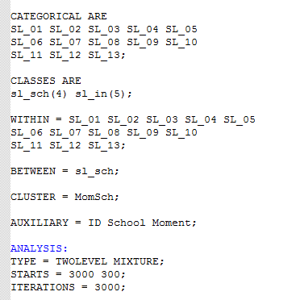
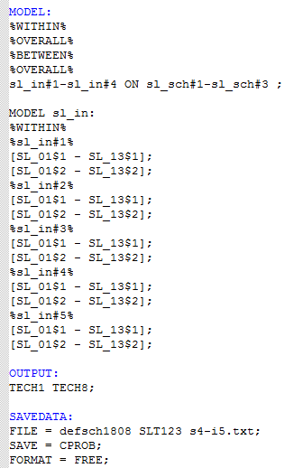
Code

Slide 12
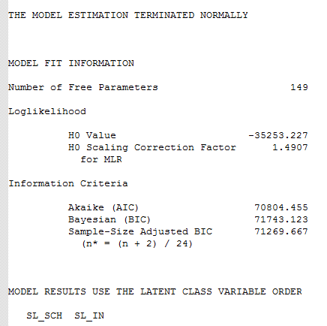
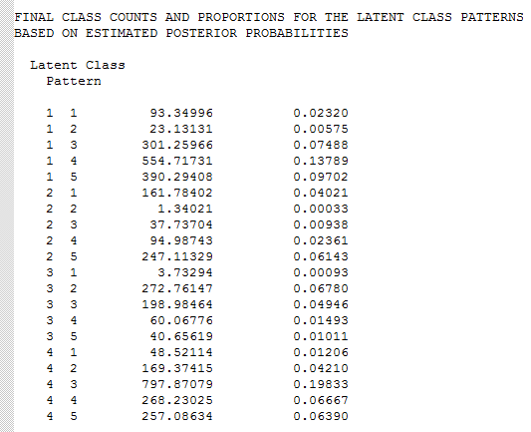
Output

Slide 13
ML LCA – Model Selection
Based on Lukociene et al. (2010), BIC(K), using the number of higher-level units (K) (schools) instead of the number of lower-level units (N), was used.
BIC penalizes by the number of parameters (r) and the sample size, BIC(K) is expressed as:
Lukociene, O., Varriale, R., & Vermunt, J. K. (2010). The simultaneous decision(s) about the number of lower- and higher-level classes in multilevel latent class analysis. Social Methodology, 1(40), 247–283.

Slide 14
Compare BIC(K)
Run models for all combinations of numbers of classes at school level and individual level
Individual level | School level
 | 2 | 3 | 4 | 5
2 | 79787,52 | 79733,72 | 79744,47 | 79755,69
3 | 74018,17 | 7392.19 | 73876,69 | 73882,85
4 | 72615,66 | 72503,71 | 72456,00 | 72455,93
5 | 71561,38 | 71415,49 | 71342,27 | 71333,13
Lukociene, O., Varriale, R., & Vermunt, J. K. (2010). The simultaneous decision(s) about the number of lower- and higher-level classes in multilevel latent class analysis. Social Methodology, 1(40), 247–283.

Slide 15
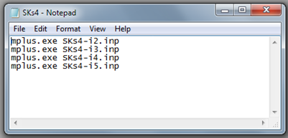
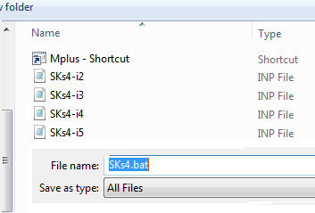
Windows Batch
Call to mplus and input files in Notepad
Start by clicking on Batch File
Save as .bat file in same folder as Mplus-shortcut and input files
Note: do not use spaces in input file names
Mplus will run all input files subsequently, output files will magically appear in the folder!

Slide 16
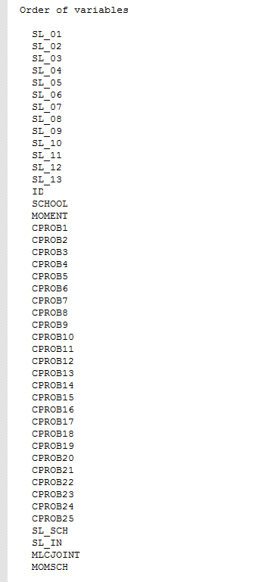
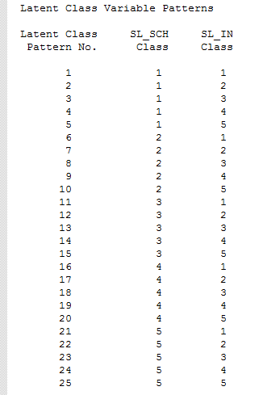
Optimal model > save file

Slide 17
Interpret & label classes – individual

Slide 18
Interpret & label classes – school
 | IC5 | IC4 | IC3 | IC1 | IC2
SC1 | 49% | 33% | 11% | 7% | 0%
SC2 | 10% | 54% | 17% | 15% | 3%
SC3 | 0% | 25% | 28% | 41% | 7%
SC4 | 3% | 8% | 60% | 20% | 8%
SC5 | 0% | 3% | 16% | 44% | 37%

Slide 19
Class assignment
For each school at every measurement occasion, the most likely class was assigned using the latent class posterior distribution obtained during the ML LCA estimation, i.e., for each school, the school class for which the probability to be assigned to was largest, was selected (Asparouhov & Muthen, 2013)
 | SC1 | SC2 | SC3 | SC4 | SC5 | Total
T1 | 13 (14%) | 37 (40%) | 22 (24%) | 11 (12%) | 9 (10%) | 92
T2 | 11 (13%) | 31 (35%) | 26 (30%) | 7 (8%) | 13 (15%) | 88
T3 | 7 (8%) | 29 (31%) | 22 (24%) | 20 (22%) | 15 (16%) | 93
Asparouhov, T., & Muthen, B. (2013). Auxiliary Variables in Mixture Modeling : 3-Step Approaches Using Mplus. Mplus Web Notes: No. 15, 1–48. Retrieved from http://www.statmodel.com/examples/webnotes/webnote15.pdf

Slide 20
Multi State Model (R)

Slide 21
MSM
Changes occur between measurement occasions
Model movement in continuous time (homogeneous continuous-time Markov model)
Only allow instantaneous transitions to adjacent states
MSM package in R (Jackson, 2014)

Slide 22
Principal stability
Person who fulfills formal role of school leader changed in 12 out of 92 schools
Principal stability is regarded important for implementation success
13 out of 80: declined
35 out of 80: stable
32 out of 80: improved

Slide 23
Transition probabilities (t=22)
Initial class | Class assigned to at the end of the intervention
 | SC1 | SC2 | SC3 | SC4 | SC5
SC1 | .20 | .44 | .22 | .09 | .05
SC2 | .11 | .38 | .28 | .14 | .09
SC3 | .04 | .20 | .33 | .22 | .21
SC4 | .02 | .13 | .30 | .24 | .31
SC5 | .01 | .06 | .22 | .24 | .47

Slide 25
Conclusions

Slide 26
Transitions limited
43.8% stability of assigned class
Improvement more likely for lower initial classes
Intervention more specifically aimed at school leader could lead to other results

Slide 27
Transitions & covariates
Initial class assignment higher for female school leaders and leaders of small schools (<100 students)
Too many transition possibilities to model covariate-specific probabilities

Slide 28
Future work
Relate school leadership to student achievement
Relate (transitions in) school leadership to (transitions in) schools’ data culture
Relate initial and final school leadership to DBDM-implementation

Slide 29
Questions?
Thank you for your attention

