Slide 1
“Applying Bayes to Real Life Data”
Rianne van Dijk
Child & Adolescent Studies (CAS)

Slide 2
Thesis research aims
Do affective dyadic flexibility (structure) and maternal negative affect (content) on the micro level indirectly predict increases in preschoolers’ externalizing problem behaviors at the macro level?
Does inhibitory control serve as important mechanism underlying the relation between mother-child interchanges (micro) and externalizing problem behaviors (macro)

Slide 3
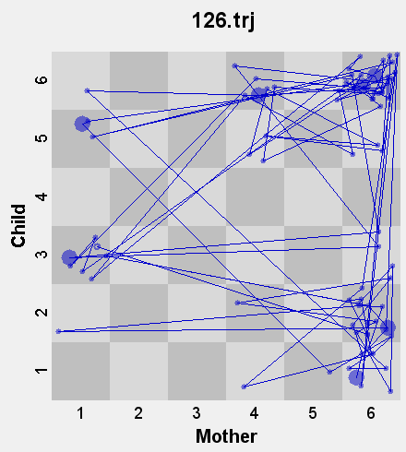
Thesis method
Predominantly clinically referred sample (N = 173)
Preschoolers (3.5 – 5.5 years) and their mothers
3 Timepoints (9 month interval) :
T1: Mother-child interactions in real time
Relationship Affect Coding System
State Space Grids
T2: Inhibitory control tasks
Go-No-Go; School Shape Inhibit; Snack Delay
T3: C-TRF1.5-5
Hyperactive/impulsive behavior and aggression
Schoemaker, K., Bunte, T., Wiebe, S.A., Espy, K.A., Deković, M., & Matthys, W. (2012). Executive function deficits in preschool children with ADHD and DBD. Journal of Child Psychology and Psychiatry, 53, 111-119.

Slide 4
Thesis conceptual model
Dyadic Flexibility T1
Hyperactive/
impulsive T3
Negative Affect
Mother T1
Inhibitory Control T2
Aggression T3
Flex*Neg T1
Hyperactive/
impulsive T1
Aggression T1
Path analysis (MLR)

Slide 5
How it all started…
Bootstrapping → model problems
Friend/statistician?
Mplus Discussion Board?
Literature?
Bayes
Bayes
Bayes
e.g., Yuan, Y., & MacKinnon, D. P. (2009). Bayesian mediation analysis. Psychological Methods, 14, 301-322.

Slide 6
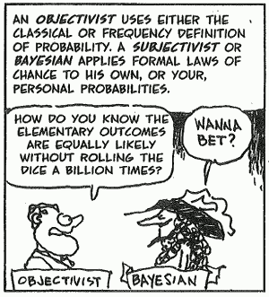
Bayes
Depaoli, S., & Van de Schoot, A.G.J. (2015). Improving Transparency and Replication in Bayesian Statistics: The WAMBS-Checklist. Psychological methods. Advance online publication. doi:10.1037/met0000053

Slide 7
Difficulties
Insecurity

Slide 8
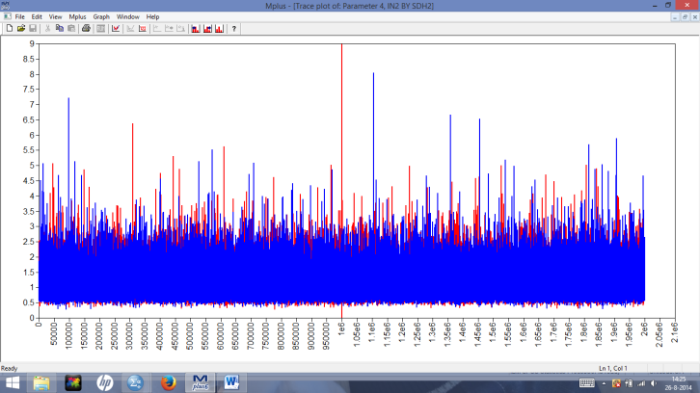
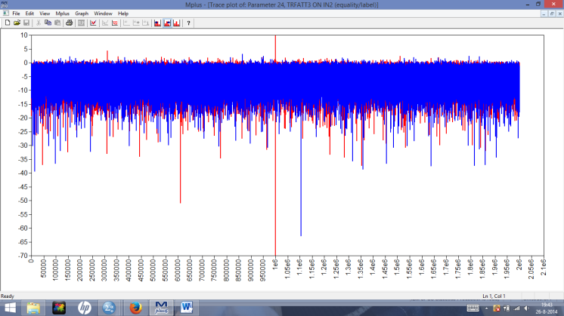
For example

Slide 9
Difficulties
Insecurity
TIME
Results

Slide 10
Results: Model Estimates of Coefficients (MLR; N = 173)
 | b | SE of b | β | p
Paths a (predictor → mediator) Dyadic flexibility T1 → Inhibitory control T2 Negative affect mother T1 → Inhibitory control T2 Flex*Neg T1 → Inhibitory control T2 Paths b (mediator → outcome) Inhibitory control T2 → Hyperactive/impulsive T3 Inhibitory control T2 → Aggression T3 Paths c’ (mediator → outcome) Dyadic flexibility T1 → Hyperactive/impulsive T3 Negative affect mother T1 → Hyperactive/impulsive T3 Flex*Neg T1 → Hyperactive/impulsive T3 Dyadic flexibility T1 → Aggression T3 Negative affect mother T1 → Aggression T3 Flex*Neg T1 → Aggression T3 Stability measures Hyperactive/impulsive T1 → Hyperactive/impulsive T3 Aggression T1 → Aggression T3 | -.08 -.04 .01 -8.05 -2.62 -.12 -.28 .13 .12 .00 .36 .26 .36 | .04 .02 .01 2.61 1.80 .43 .23 .06 .35 .20 .36 .06 .06 | -.32 -.44 .35 -.46 -.17 -.03 -.18 .21 .03 .00 .11 .32 .48 | .047 .042 .029 .002 .143 .782 .219 .051 .733 .993 .317 .000 .000
“Since the results from the analyses using a Bayesian estimator yielded similar results regarding the direction of effects, Bayesian results are omitted here. See Appendix for detailed specifications of our Bayesian analysis and results.”

Slide 11
Difficulties
Insecurity
TIME
Results
Intelligible writing

Slide 12
“Three parameter estimates did exceed the bias level of |1|%, but this was due to the small value of the estimates (e.g., -.079 and -.078), for which differences in estimates of only Δb = .001 are already postulated as biased. Hence, these differences in estimates were not considered as problematic and our post burn-in value of 500,000 was deemed sufficient.”
“We specified an initial burn-in phase of 500,000 iterations, with a fixed number of post burn-in iterations of also 500,000. The number of iterations were established after checking the BGR diagnostic and visually inspecting trace plots for each model parameter (i.e., both Markov chains had to be visually stacked with a constant mean and variance in the post burn-in portion of the chain).”
“Starting values based on the ML-estimates were used and two Markov chains were implemented for each parameter. The Brooks, Gelman, and Rubin (BGR) convergence diagnostic was applied as described in the Mplus manual, but a stricter convergence criterion of 0.01 rather than the default setting of 0.05 was used.”

